Slide 1
A Convolutional Neural Network Cascade for Face Detection
201912056 Noh Sujin Option 1-8
Paper link: https://openaccess.thecvf.com/content_cvpr_2015/html/Li_A_Convolutional_Neural_2015_CVPR_paper.html

Slide 2
Contents
1. Research purpose
2. Research process
3. Conclusion

Slide 3
The difficulties in face detection
1. Research purpose
1. the large visual variations of human faces in the cluttered backgrounds 2. the large search space of possible face positions and face sizes
The boosted cascade
In the past, the most popular and effective design for practical face detection. However, due to the simple nature of the Haar feature, it is relatively weak in the uncontrolled environment where faces are in varied poses, expressions under unexpected lighting.
Therefore, this paper proposes a cascade architecture built on convolutional neural networks (CNNs) with very powerful discriminative capability, while maintaining high performance to address problems.

Slide 4
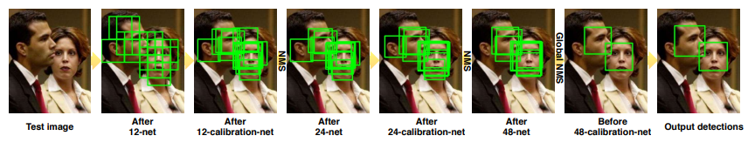
2. Research process
CNN-based calibration stage after each of the detection stages in the cascade
Test pipeline of our detector

Slide 5
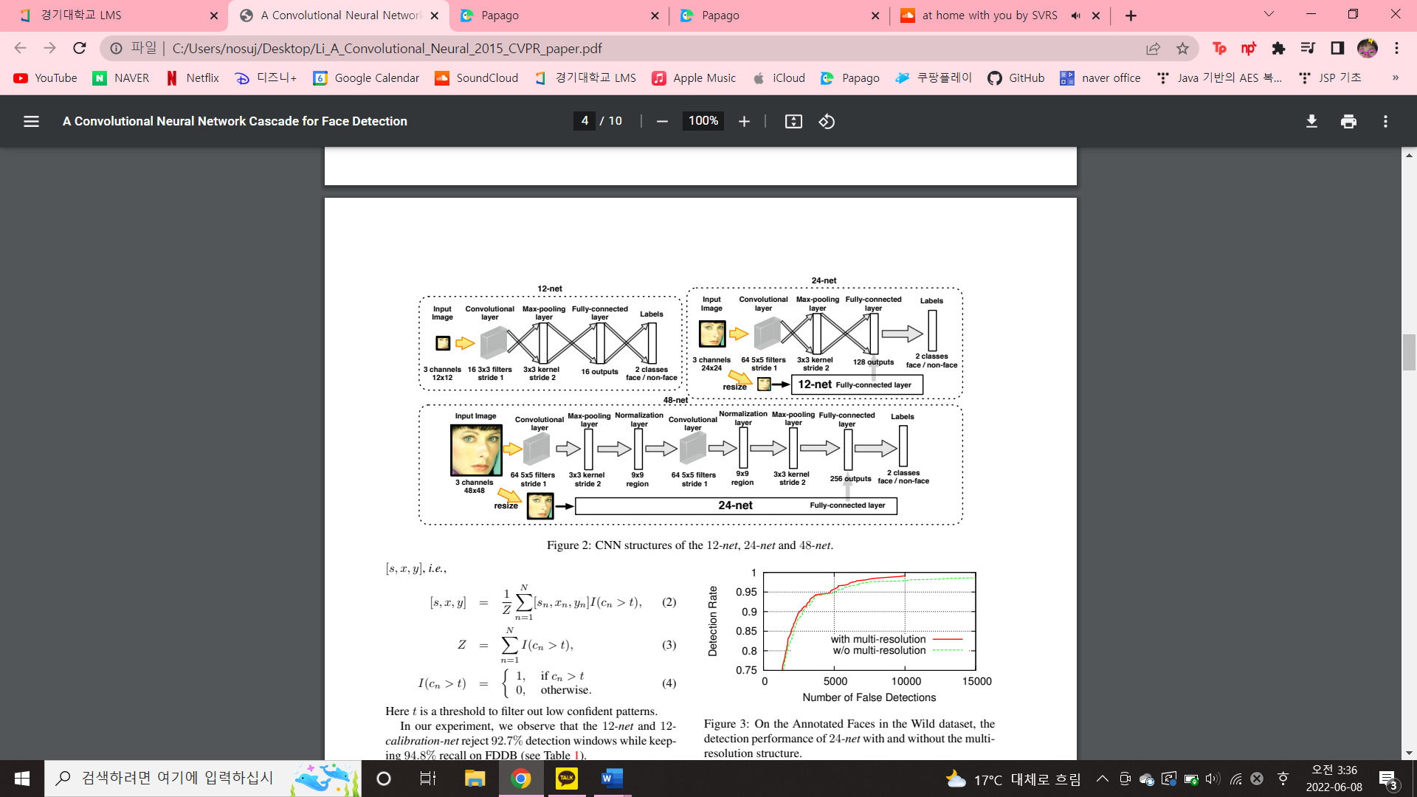
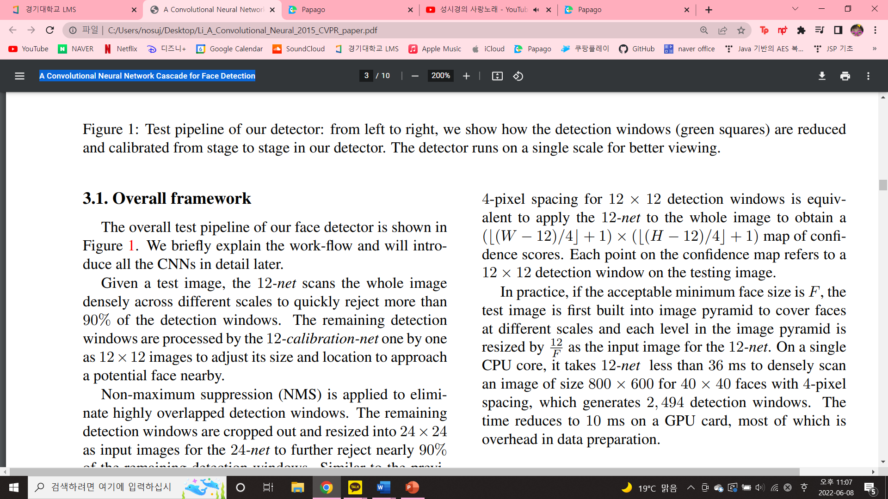
2. Research process
1) 12-net
A very shallow binary classification CNN to quickly scan the testing image.
Densely scanning an image of size W × H with 4-pixel spacing for 12 × 12 detection windows is equivalent to apply the 12-net to the whole image to obtain a map of confidence scores.
Each point on the confidence map refers to a 12 × 12 detection window on the testing image.

Slide 6
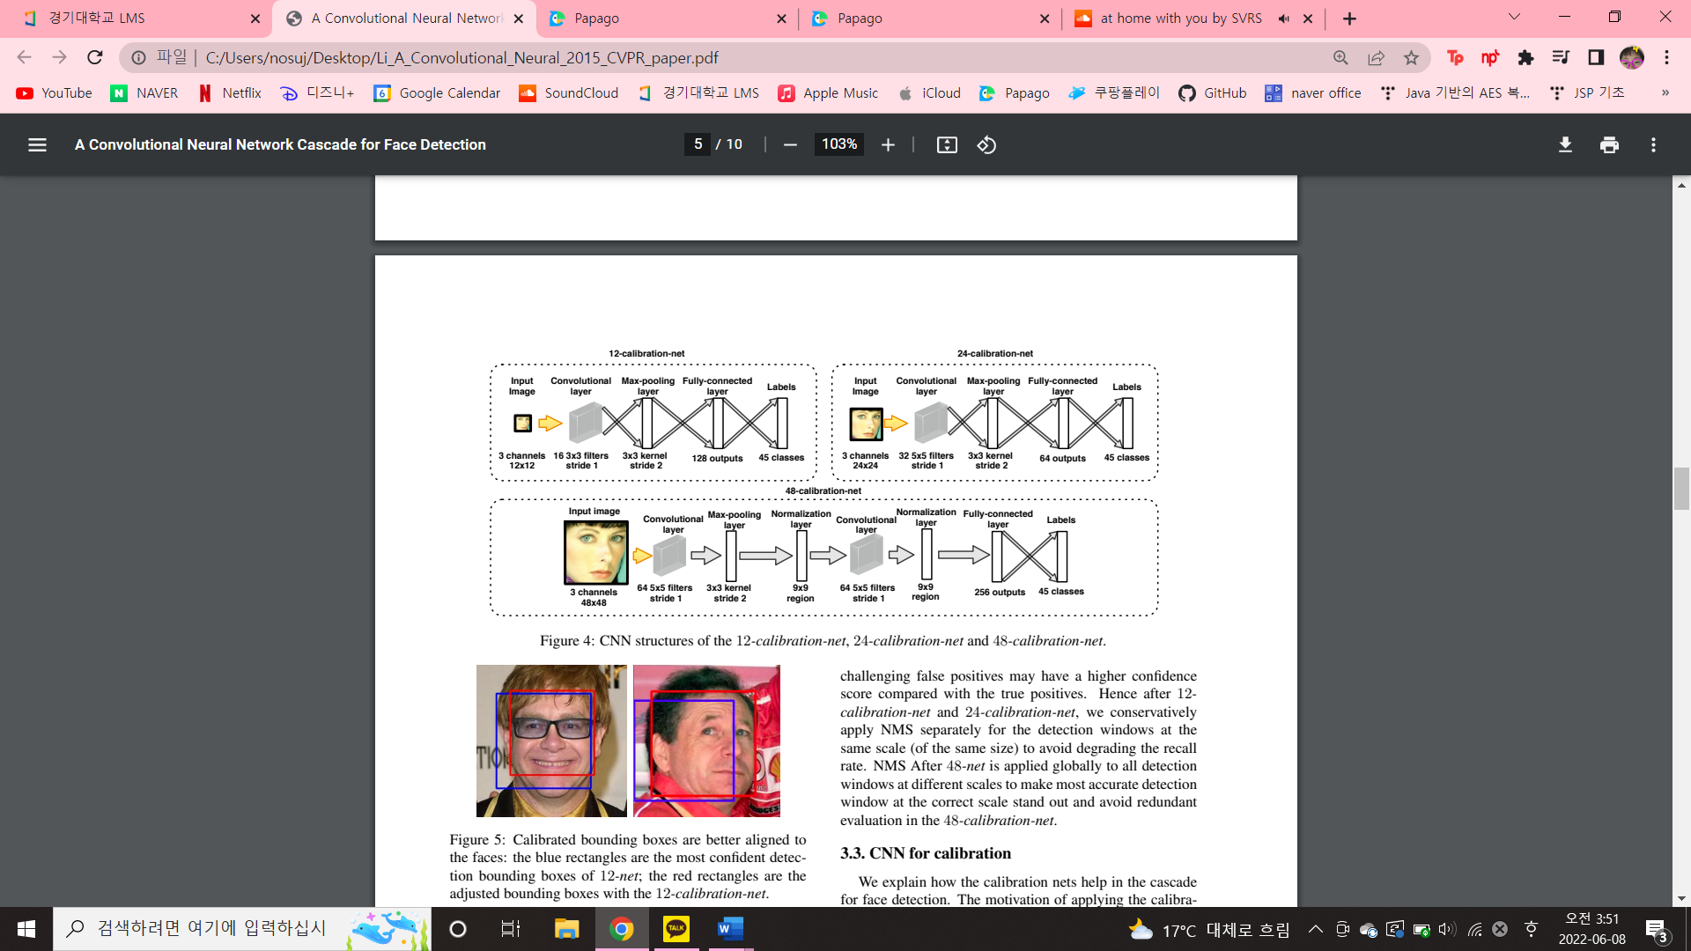
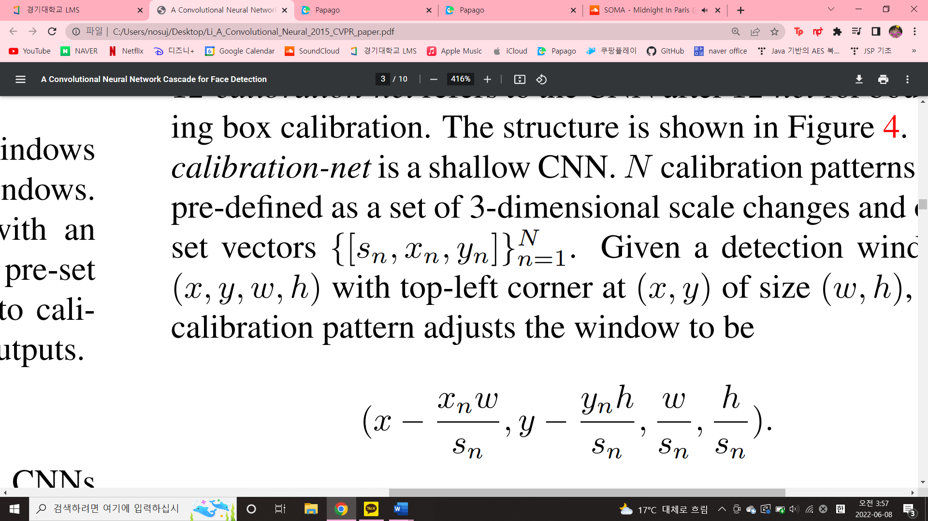
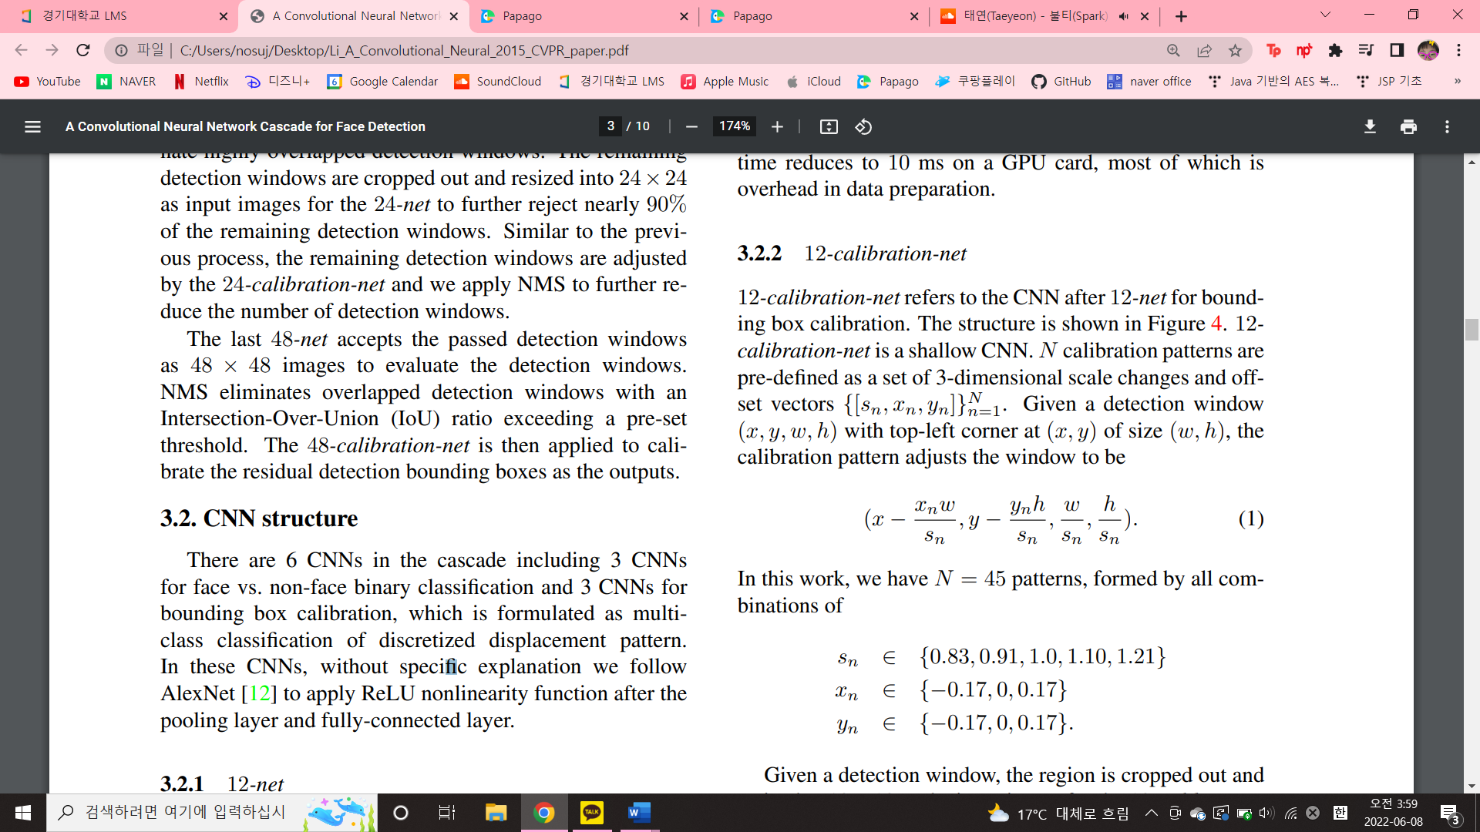
2. Research process
2) 12-calibration-net
a shallow CNN after 12-net for bounding box calibration.
N calibration patterns are pre-defined as a set of 3-dimensional scale changes and off-set vectors
Given a detection window (x, y, w, h) with top-left corner at (x, y) of size (w, h), the calibration pattern adjusts the window to be
In this work, we have N = 45 patterns, formed by all combinations of Sn ∈ {0.83, 0.91, 1.0, 1.10, 1.21} Xn ∈ {−0.17, 0, 0.17} Yn ∈ {−0.17, 0, 0.17}.

Slide 7
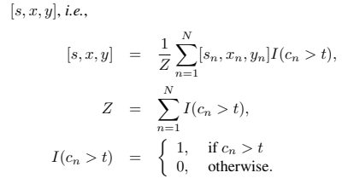
2. Research process
2) 12-calibration-net
Given a detection window, the region is cropped out and resized to 12×12 as the input image for the 12-calibrationnet.
The calibration net outputs a vector of confidence scores [c1, c2, · · · , cN ]
Since the calibration patterns are not orthogonal to each other, we take the average results of the patterns of high confidence score as the adjustment
Here t is a threshold to filter out low confident patterns.

Slide 8
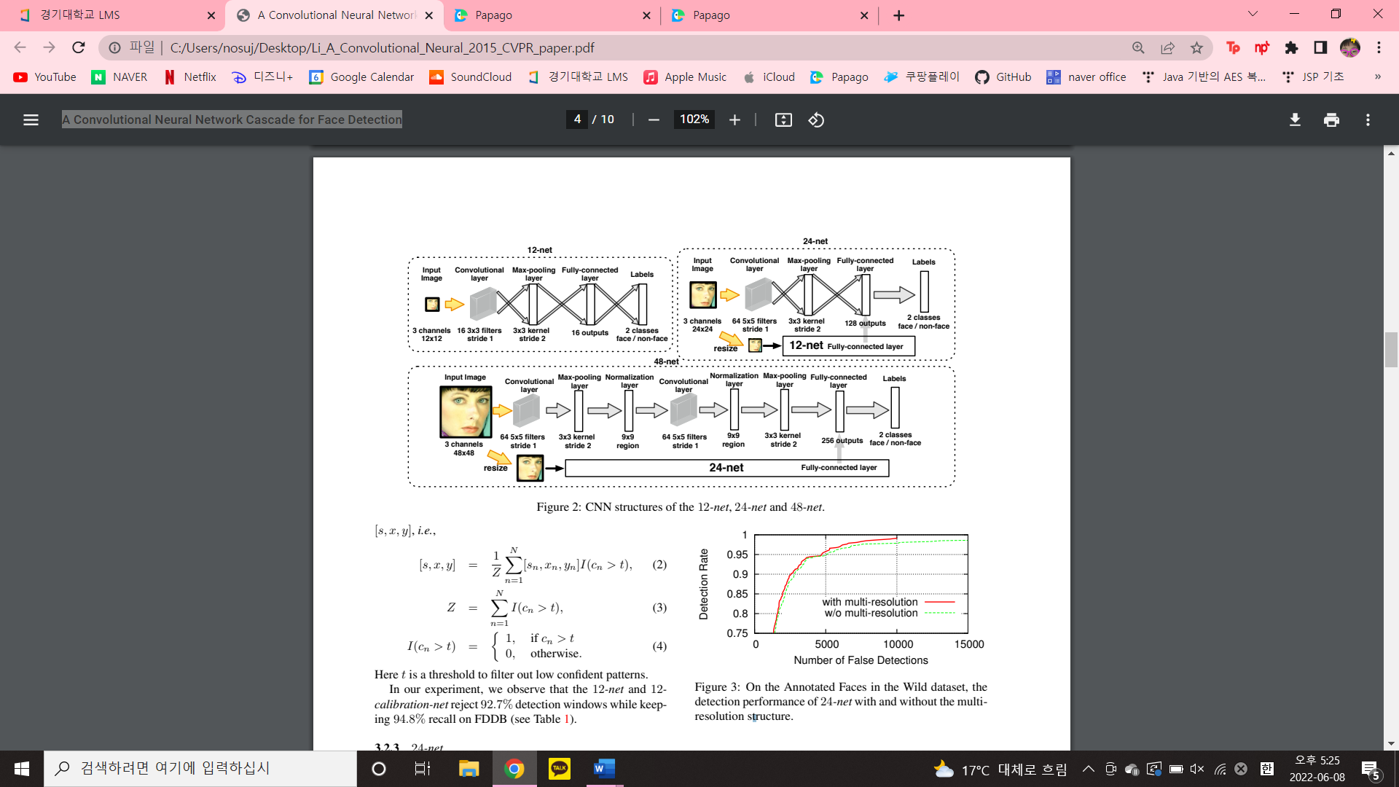
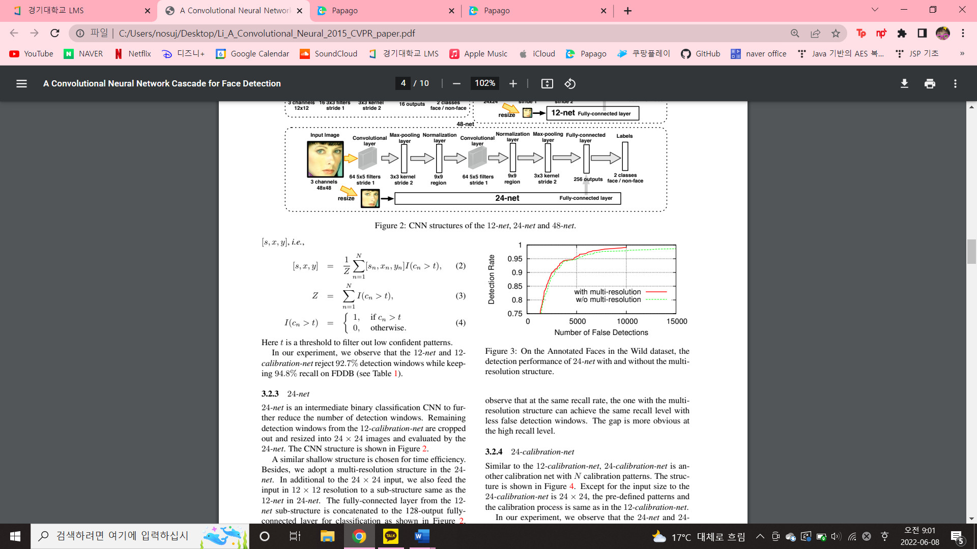
2. Research process
3) 24-net
An intermediate binary classification CNN to further reduce the number of detection windows.
Remaining detection windows from the 12-calibration-net are cropped out and resized into 24 x 24 images and evaluated by the 24-net.
A similar shallow structure is chosen for time efficiency.
multi-resolution structure

Slide 9
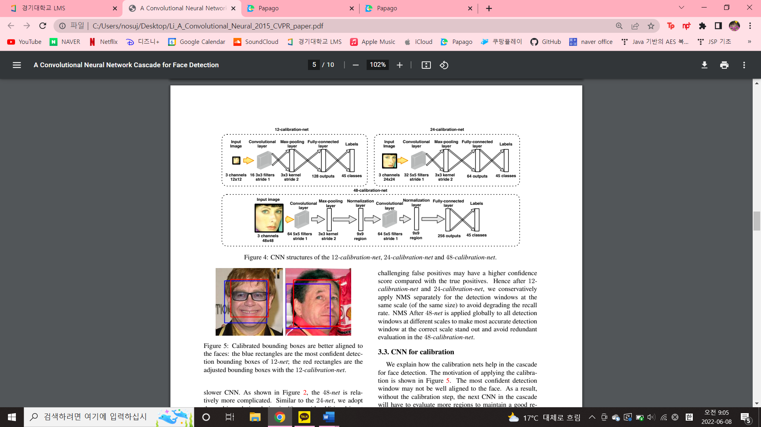
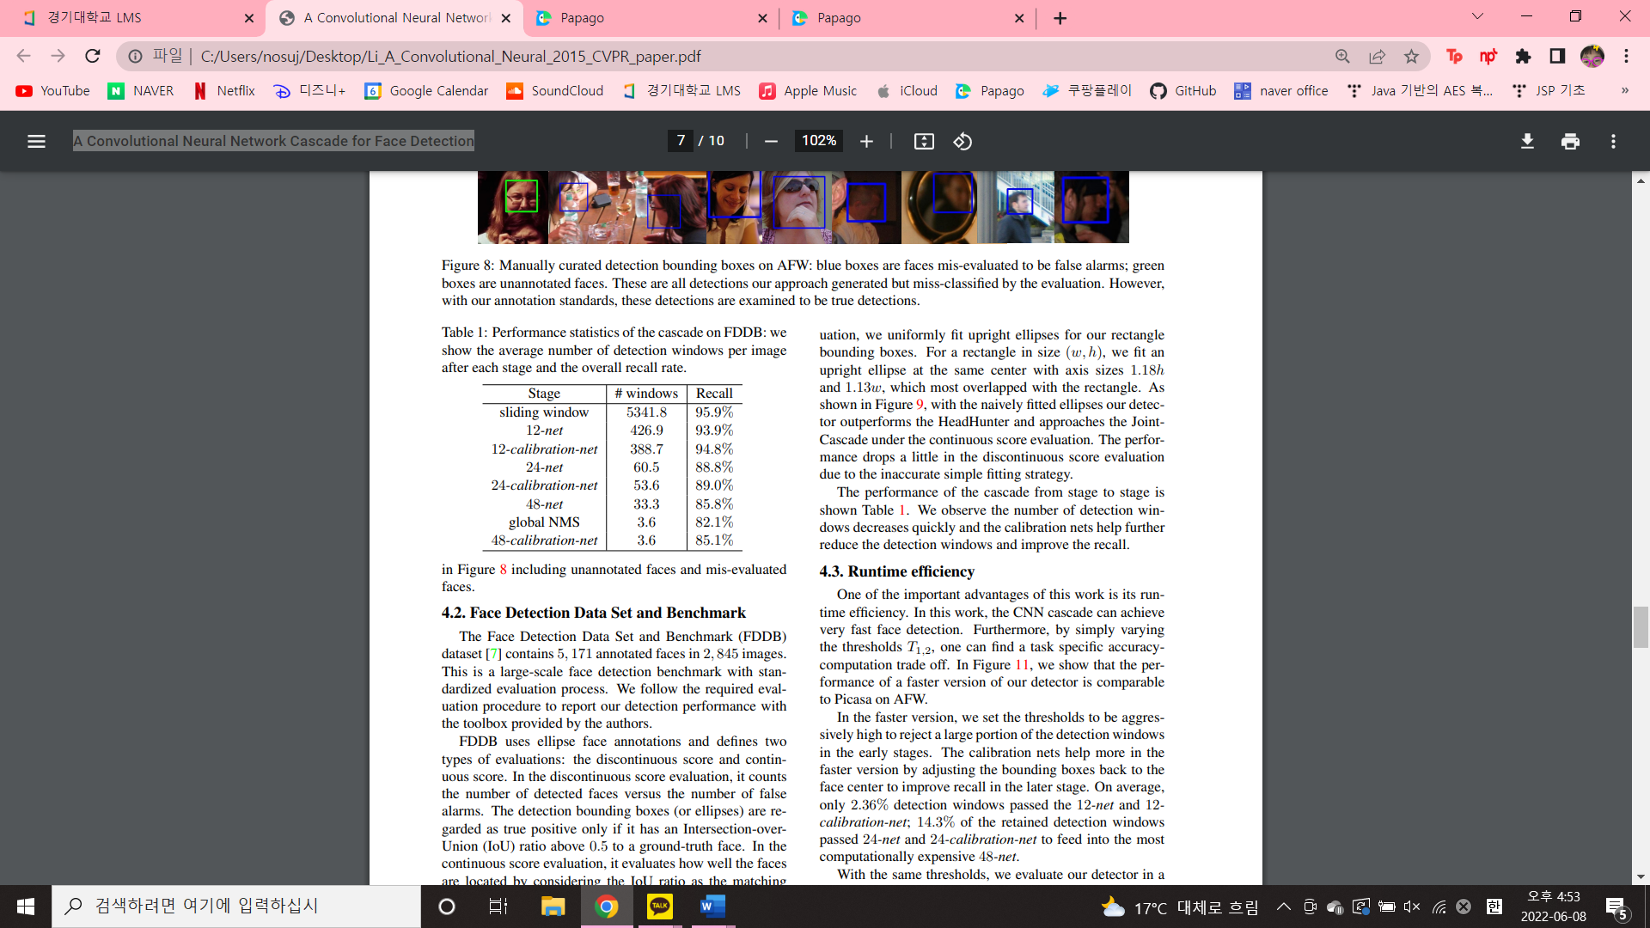
2. Research process
4) 24-calibration-net
- The predefined patterns and the calibration process is same as in the 12-calibration-net, Except for the input size to the 24-calibration-net is 24 x 24.

Slide 10
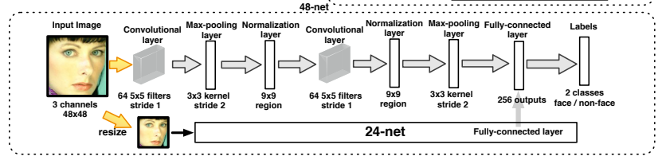
2. Research process
5) 48-net
The last binary classification CNN and relatively more complicated.
Similar to the 24-net, we adopt the multi-resolution design in 48-net with additional input copy in 24 x 24 and a substructure the same as the 24-net.

Slide 11
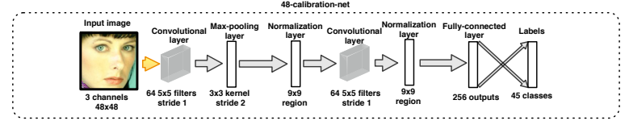
2. Research process
6) 48-calibration-net
The last stage in the cascade
The same N = 45 calibration patterns are pre-defined for the 48-calibration-net. We use only one pooling layer in this CNN to have more accurate calibration.

Slide 12
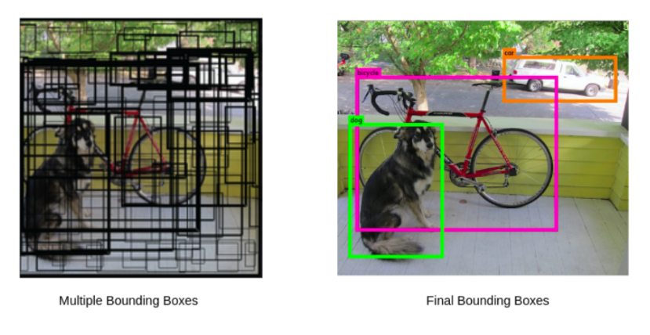
2. Research process
Non-Maximum Suppression (NMS)
NMS After 48-net is applied globally to all detection windows at different scales to make most accurate detection window at the correct scale stand out and avoid redundant evaluation in the 48-calibration-net.

Slide 13
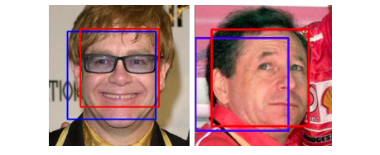
2. Research process
CNN for calibration
The motivation of applying the calibration is
As a result, without the calibration step, the next CNN in the cascade will have to evaluate more regions to maintain a good recall. The overall detection runtime increases significantly.
To address this problem, we train a multi-class classification CNN for calibration.
As shown above figure, after calibration the detection bounding box is better aligned to the real face center.

Slide 14
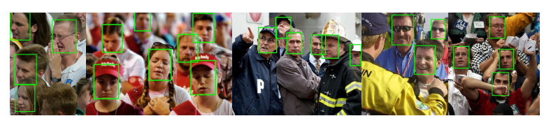
3. Conclusion
In this study, we present a CNN cascade for fast face detection.
Calibration nets are introduced in the cascade to accelerate detection and improve bounding box quality.

